Slide 1

IT2413
Web Programming
Week 7 Server side programming
PHP Scripting Language
MySQL Database
Apache Server

Slide 2
PHP Cookies
A cookie is often used to identify a user.
Cookie is a small file that the server embeds on the user's computer.
Each time the same computer requests a page with a browser, it will send the cookie too. With PHP, you can both create and retrieve cookie values.

Slide 3
Create a Cookie in PHP
The setcookie() function is used to set a cookie.
Note: The setcookie() function must appear BEFORE the <html> tag.
Syntax
setcookie(name, value, expire, path, domain);

Slide 4
Example1
<?php
setcookie("user", "Alex Porter", time()+3600);
?>
<html>
….. Code for execute…..
</html>

Slide 5

Example2
<html>
<head><title>Cookie</title></head>
<body>
<form method=POST action="cookie.php">
<label>Name:<Input type="text " name="name"></label>
<input type="submit" value="Go...">
</form>
</body>
</html>

Slide 6
Example2 contd.
<?php
setcookie("name", $_POST['name'], time()+3600); if(isset($_COOKIE['name']))
{
$n=$_COOKIE['name'];
echo "Thank You". $n;
}
else
{
echo "may be your first visit or cookie is not set try again...";
}
?>
Notes:
setcookie("name",$_POST['name'],time()+600,“/php/","localhost",0)
Path,domain

Slide 7
Delete a Cookie in PHP
setcookie("name",$_POST['name'],time()-600);
You should also ensure that your past setcookie the same name, same path, domain and secure parameters as originally setting the cookie

Slide 8
Session
A session is a combination of a server-side file containing all the data you wish to store, and a client-side cookie containing a reference to the server data.
The file and the client-side cookie are created using the function session_start() - it has no parameters, but informs the server that sessions are going to be used.

Slide 9
Starting a session
session_start()
Example
<?php
session_start();
echo “Session is started…";
?>

Slide 10
Exercise
<?php
session_start();
echo session_id();
?>
Notes:
Session cookie –lifetime() in php.ini

Slide 11
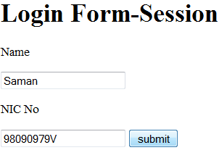
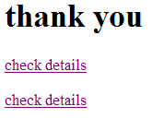

Exercise

Slide 12
loginsession.html
<html>
<head><title>login form</title></head>
<body>
<h1>Login Form</h1>
<form method="POST" action="loginsession.php">
<p> Name </p> <input type="text" name="name" value="" size=20 />
<p> NIC No</p> <input type=“text" name=“NIC" value="" size=20 />
<input type="submit" name=“submit" value=“submit" />
</form>
</body>
</html>

Slide 13
loginsession.php
<?php
session_start();
$_SESSION['name']=$_POST['name'];
$_SESSION['NIC']=$_POST['NIC'];
echo "<h1>thank you</h1>";
echo "<p> <a href=\"session.php\">check details</a></p>";
?>
<html>
<body>
<a href="session.php">check details</a>
</body>
</html>

Slide 14
Session.php
<?php
session_start();
if(isset($_SESSION['name'])){
echo "NAME:".$_SESSION['name']."</br>";
echo "NIC:".$_SESSION['NIC']."</br>";
}
else
{
echo "Session Expired";
}
?>

Slide 15
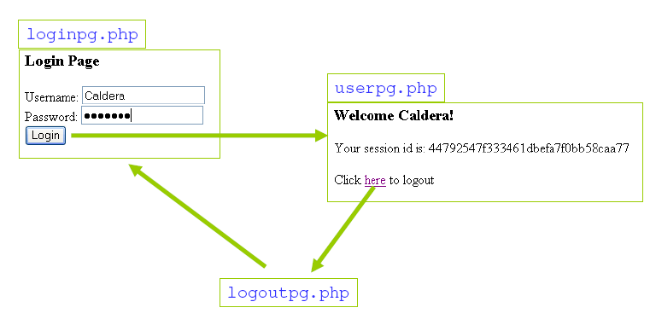
Example

Slide 16
Loginpg.php
<?php
if(isset($_SESSION['userid'])){
header('location:userpg.php');
}
elseif(isset($_POST["login"]) && ($_POST["login"]=='login')) {
session_start();
$_SESSION['userid']=$_POST["uname"];
header('location:userpg.php');
}
?>
<html>
<body>
<h3> login Page</h3>
<form name="form1" method="post" action="loginpg.php">
User Name: <input name="uname" type="text"><br>
Password: <input name="passwd" type="password"><br>
<input type="submit" name="login" value="login">
</form>
</body>
</html>

Slide 17
Userpg.php
<?php
session_start();
if(!isset($_SESSION['userid'])||!$_SESSION['userid']){
header('location:loginpg.php');
}
?>
<html>
<body>
<h3> Welcome <?php echo $_SESSION['userid'] ?> !</h3>
<p> Your Session ID is : <?php echo session_id() ?> </p>
<p> Click <a href="logoutpg.php">here</a> to logout</p>
</body>
</html>

Slide 18
Logoutpg.php
<?php
session_start();
$_SESSION=array();
session_destroy();
header('location:loginpg.php');
?>

Slide 19
Delete a session
session_destroy();
Or
$_SESSION['name'] = FALSE;
Or
unset($_SESSION['name']);

Slide 20
END.

